Slide 1

Service Mesh 4.4.4 Install Test May 21,2020
gwest@redhat.com

Slide 2
Overview
Bare Metal Install
Clean Install – 3 masters 3 workers
8 Cores each
Openshift 4.4.4
OVN Networking
Install Service Mesh per Documentation

Slide 3
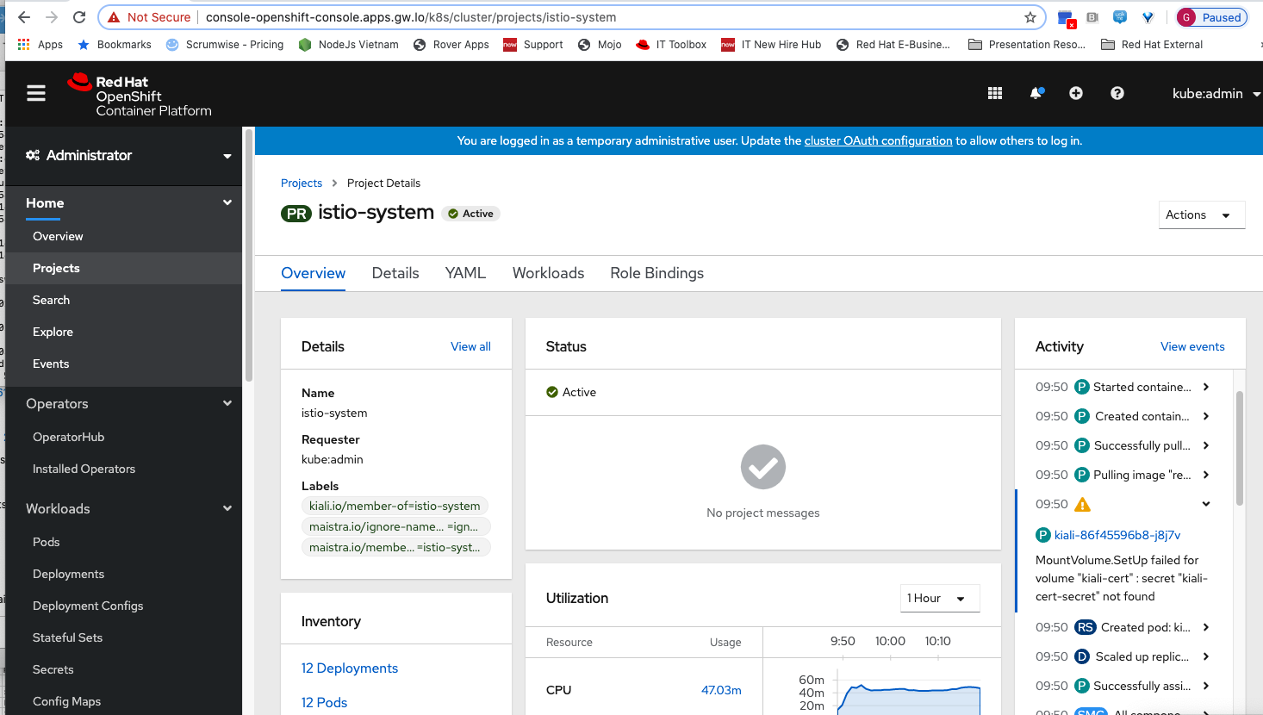
Look like a cert issue

Slide 4
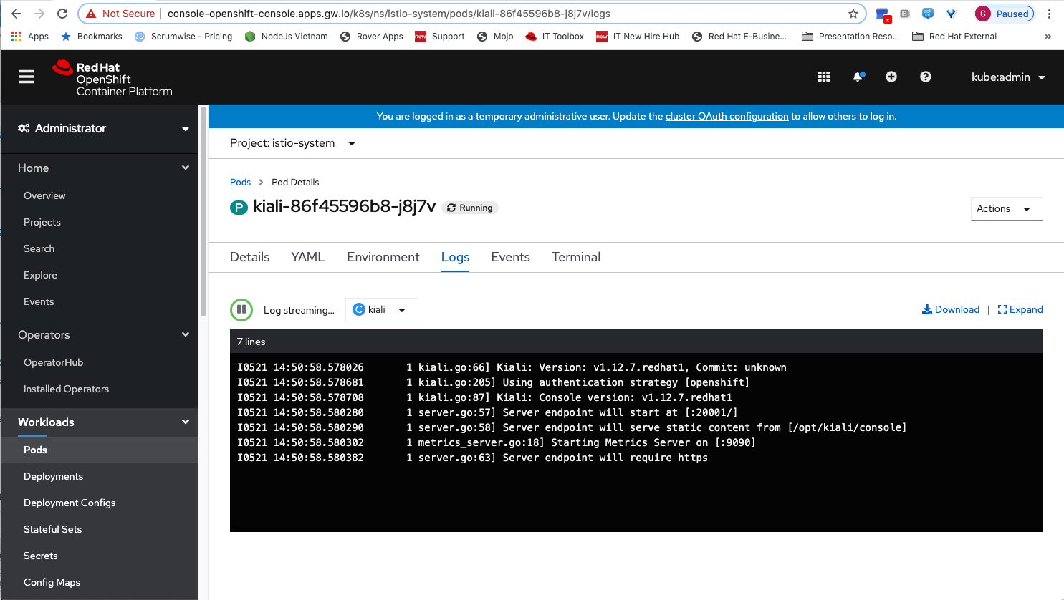
Pod looks ok

Slide 5
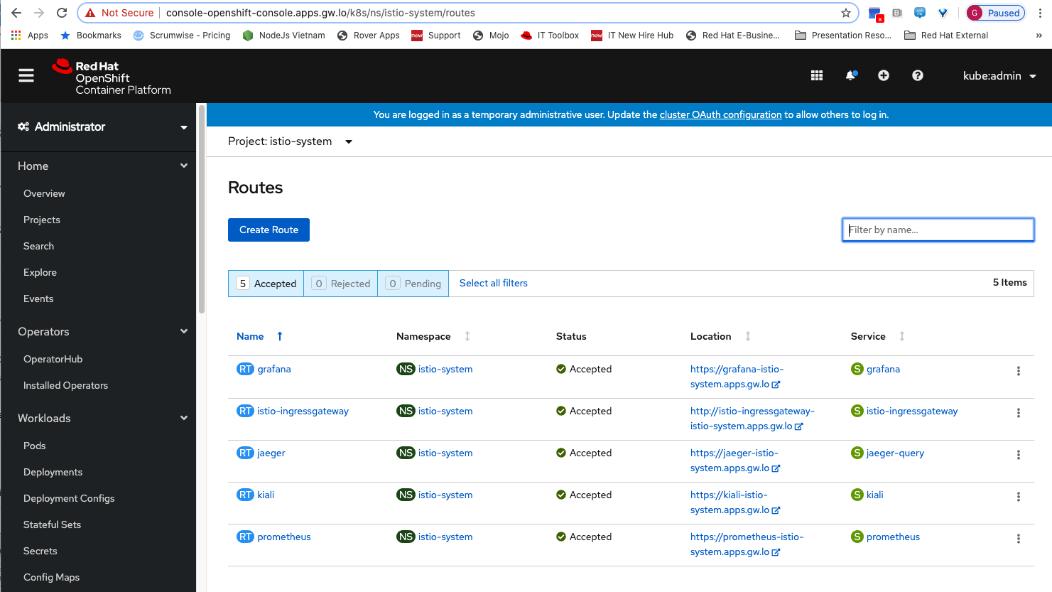
Routes

Slide 6
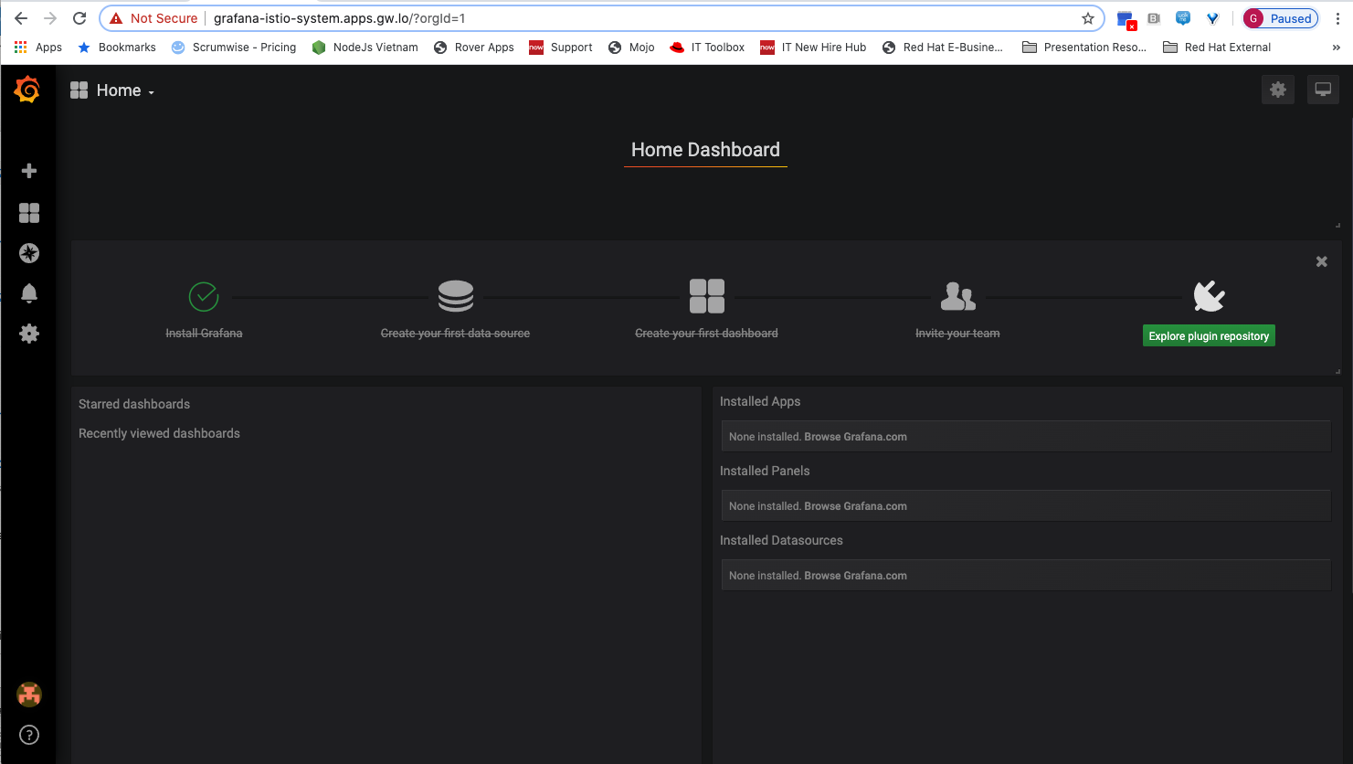
Graphana Seems fine

Slide 7
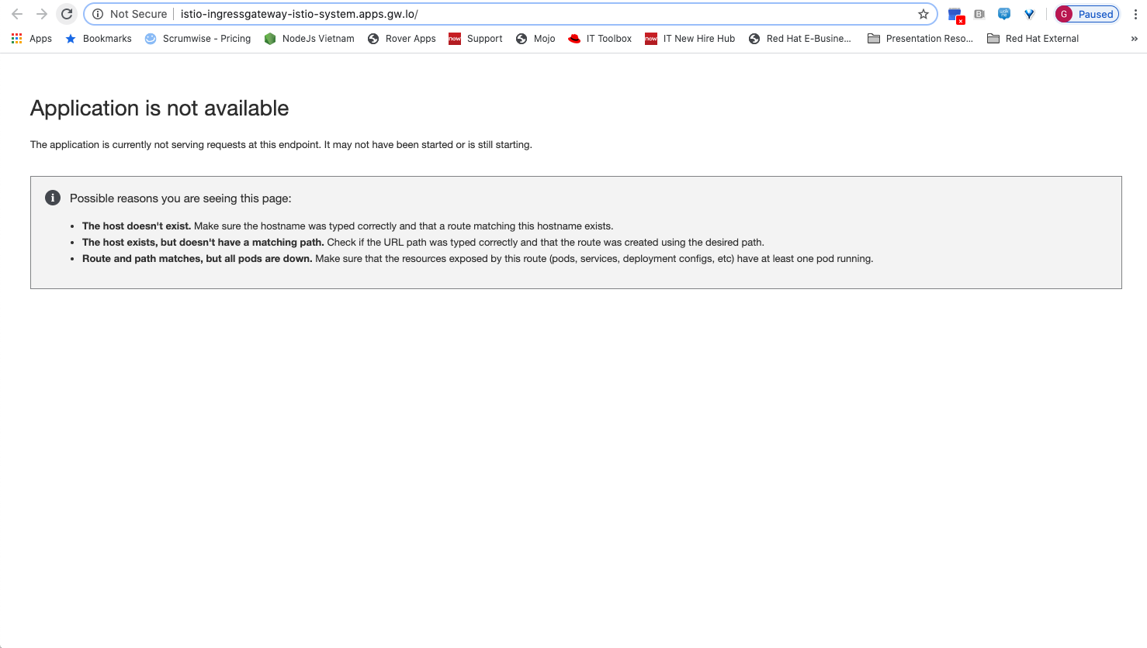
Ingress: Expected?

Slide 8

Jaeger looks fine

Slide 9

Kiali – Broken – It seems to set there forever

Slide 10
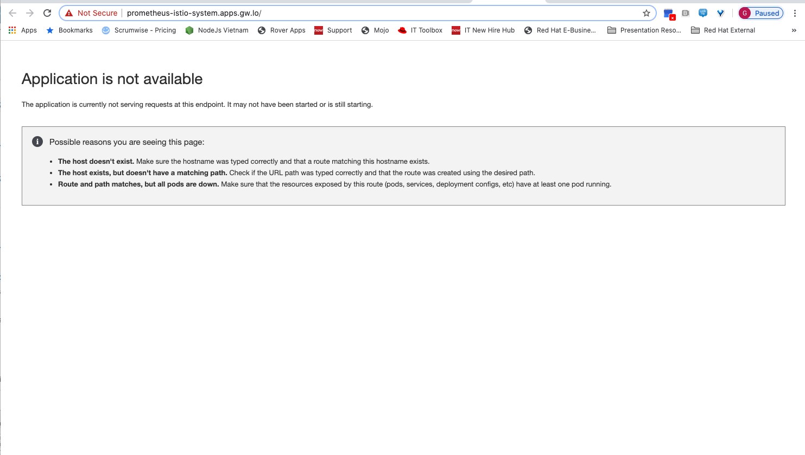
Prometheus Broken

